Slide 1
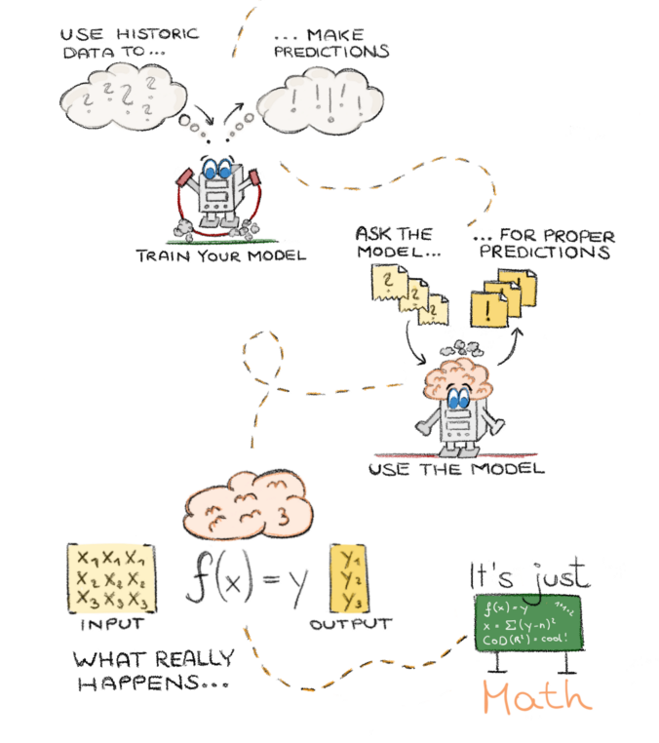

Machine Learning for the noob
a Microsoft services overview
Manu Rink
Software Engineer
@

Slide 2
🚫
🤖

Slide 3
ML is no magic 🧚‍♀️
ML is just math 📈

Slide 4
Services
Customized Services
DYI
e.g. Cognitive Services
e.g. Custom Vision Service
e.g. ML Studio / own training

Slide 5
Cognitive Services

Slide 6
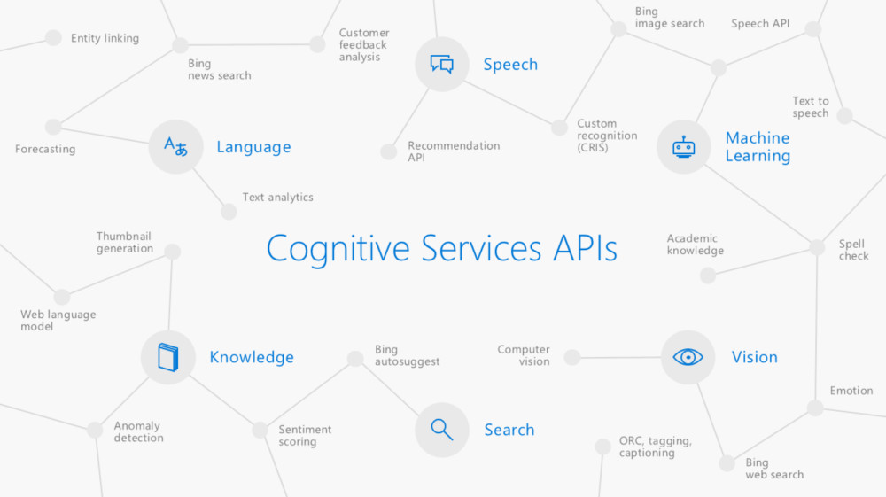
… what do you want to do?

Slide 7

Video Indexer . ai

Slide 8

See
Hear
Read
Understand
Speech
Humans
Sentiment
Topics
🤘 with full API support

Slide 9

Demo
🎬 📔
Video Indexer

Slide 10
[
Analyze
Describe
Thumbnail
OCR
Computer Vision API

Slide 11
Computer Vision API
Analyze an image
https://$region.api.cognitive.microsoft.com/vision/v1.0[?visualFeatures][&details]
URL parameters
Visual features
Categories, Tags, Description, Faces, ImageType, Color, Adult
Details
Currently just “Celebrities” is supported
Header
Content-Type application/json, application/octet-stream, multipart/form-data
Ocp-Apim-Subscription-Key
Get your key from “My account” at https://www.microsoft.com/cognitive-services/.
You might have to create an account first.
Documentation: https://azure.microsoft.com/en-us/services/cognitive-services/computer-vision/
API Reference: https://westus.dev.cognitive.microsoft.com/docs/services/56f91f2d778daf23d8ec6739/operations/56f91f2e778daf14a499e1fa
Notes:
By just uploading an image or attaching the URL of it a rich set of visual features will be extracted and returned based on the image content
DETAILS:
String indicating which domain-specific details to return

Slide 12
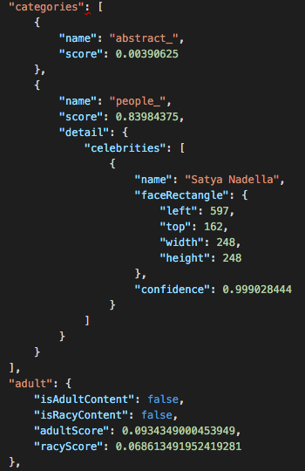
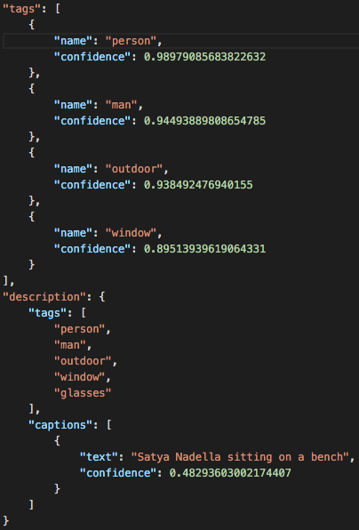
Computer
Vision API
JSON result for analyzed image
Details “Celebrities”
Visual features “Categories, Tags, Description, Adult”

Slide 13
Computer Vision API
Describe an image
https://$region.api.cognitive.microsoft.com/vision/v1.0/describe[?maxCandidates]
URL parameters - maxCandidates
Header - see “Analyse”
Get Thumbnail
https://$region.api.cognitive.microsoft.com/vision/v1.0/generateThumbnail[?width][&height][&smartCropping]
URL parameters – width, height, smartCropping
Header - see “Analyse”
OCR
https://$region.api.cognitive.microsoft.com/vision/v1.0/ocr[?language][&detectOrientation ]
URL parameters – language, detectOrientation
Header - see “Analyse”
Notes:
Describe:
generates a thumbnail image with the user-specified width and height.
By default, the service analyzes the image, identifies the region of interest (ROI), and generates smart cropping coordinates based on the ROI.
Smart cropping helps when you specify an aspect ratio that differs from that of the input image e.g. 4:3 original -> result should be 16:9 – smart cropping makes sure that all “needed” features are still on the crop
OCR
extracts the recognized characters into a machine-usable character stream.
BCP-47 language code of the text to be detected in the image – UNK for autodetect
tries to detect the image orientation and correct it before further processing

Slide 14
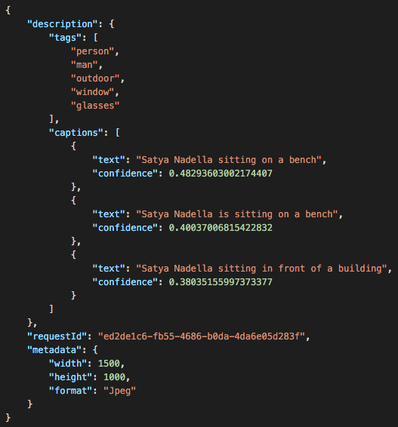
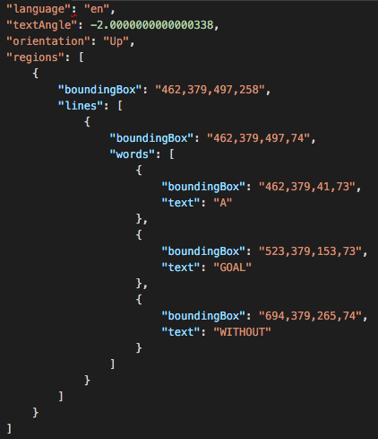
Computer
Vision API
On the left:
JSON result for OCR
On the right:
JSON result for Describe

Slide 15
[
Detect
Verify
Identify
Find Similar
Face API

Slide 16
Face API
Detect Faces
https://$region.api.cognitive.microsoft.com/face/v1.0/detect[?returnFaceId][&returnFaceLandmarks][&returnFaceAttributes]
URL parameters
returnFaceId faceId needed if face should later be attached to a person
returnFaceLandmarks
get position of e.g. eyes, pupils, nose, eyebrows,…
returnFaceAttributes
get attributes “age, gender, smile, facialHair, headPose, glasses” for a face
Header
Content-Type application/json, application/octet-stream, multipart/form-data
Ocp-Apim-Subscription-Key
Get your key from “My account” at https://www.microsoft.com/cognitive-services/.
You might have to create an account first.
Documentation: https://azure.microsoft.com/en-us/services/cognitive-services/face/
API Reference https://westus.dev.cognitive.microsoft.com/docs/services/563879b61984550e40cbbe8d/operations/563879b61984550f30395236
Notes:
Face recognition is widely used in many scenarios including security, natural user interface, image content analysis and management, mobile apps, and robotics. Four face recognition functions are provided: face verification, finding similar faces, face grouping, and person identification.
Detect Basic action for getting faces with ids, which can be further used in person groups for verification and identification
Verification – is Authentication against two detected faces or a detected face against a person
Face Grouping (face group) divide set of faces in group of similar ones – which can be considered to belong to the same person object.
Face Identification identify people based on a detected face and people database (defined as a person group) which needs to be created in advance and can be edited over time.

Slide 17
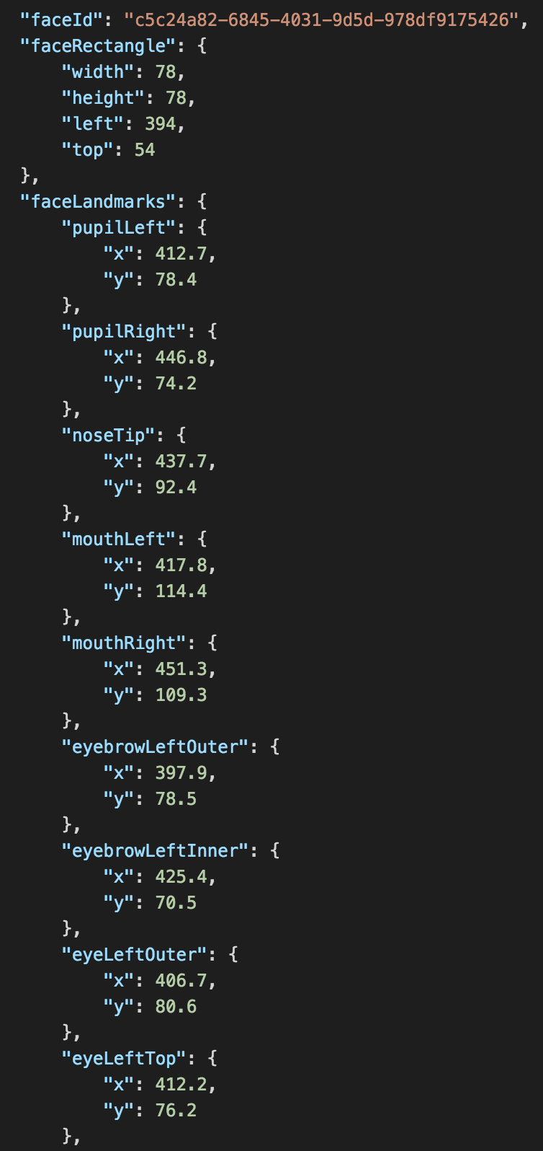
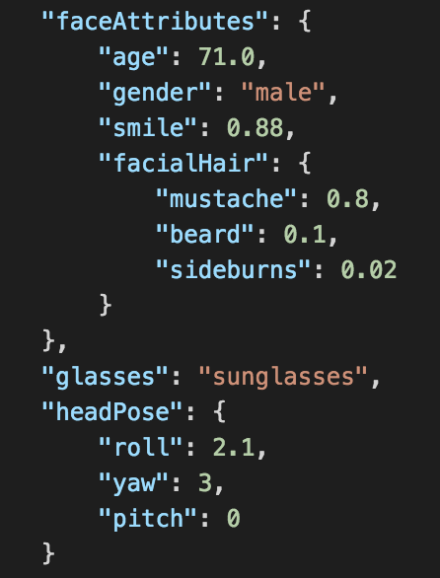
Face API
JSON result for Face Detection of an image.
For every detected face the API returns
the faceId
the list of faceLandmarks
requested attributes of the face

Slide 18
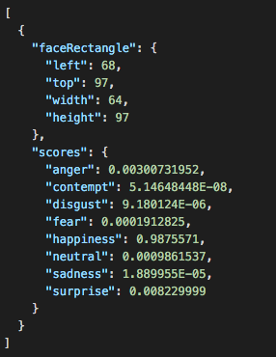
emotion
detection
JSON result for Emotion Recognition of an image.
For every detected face the API returns
the face rectangle
the list of emotions with scores

Slide 19
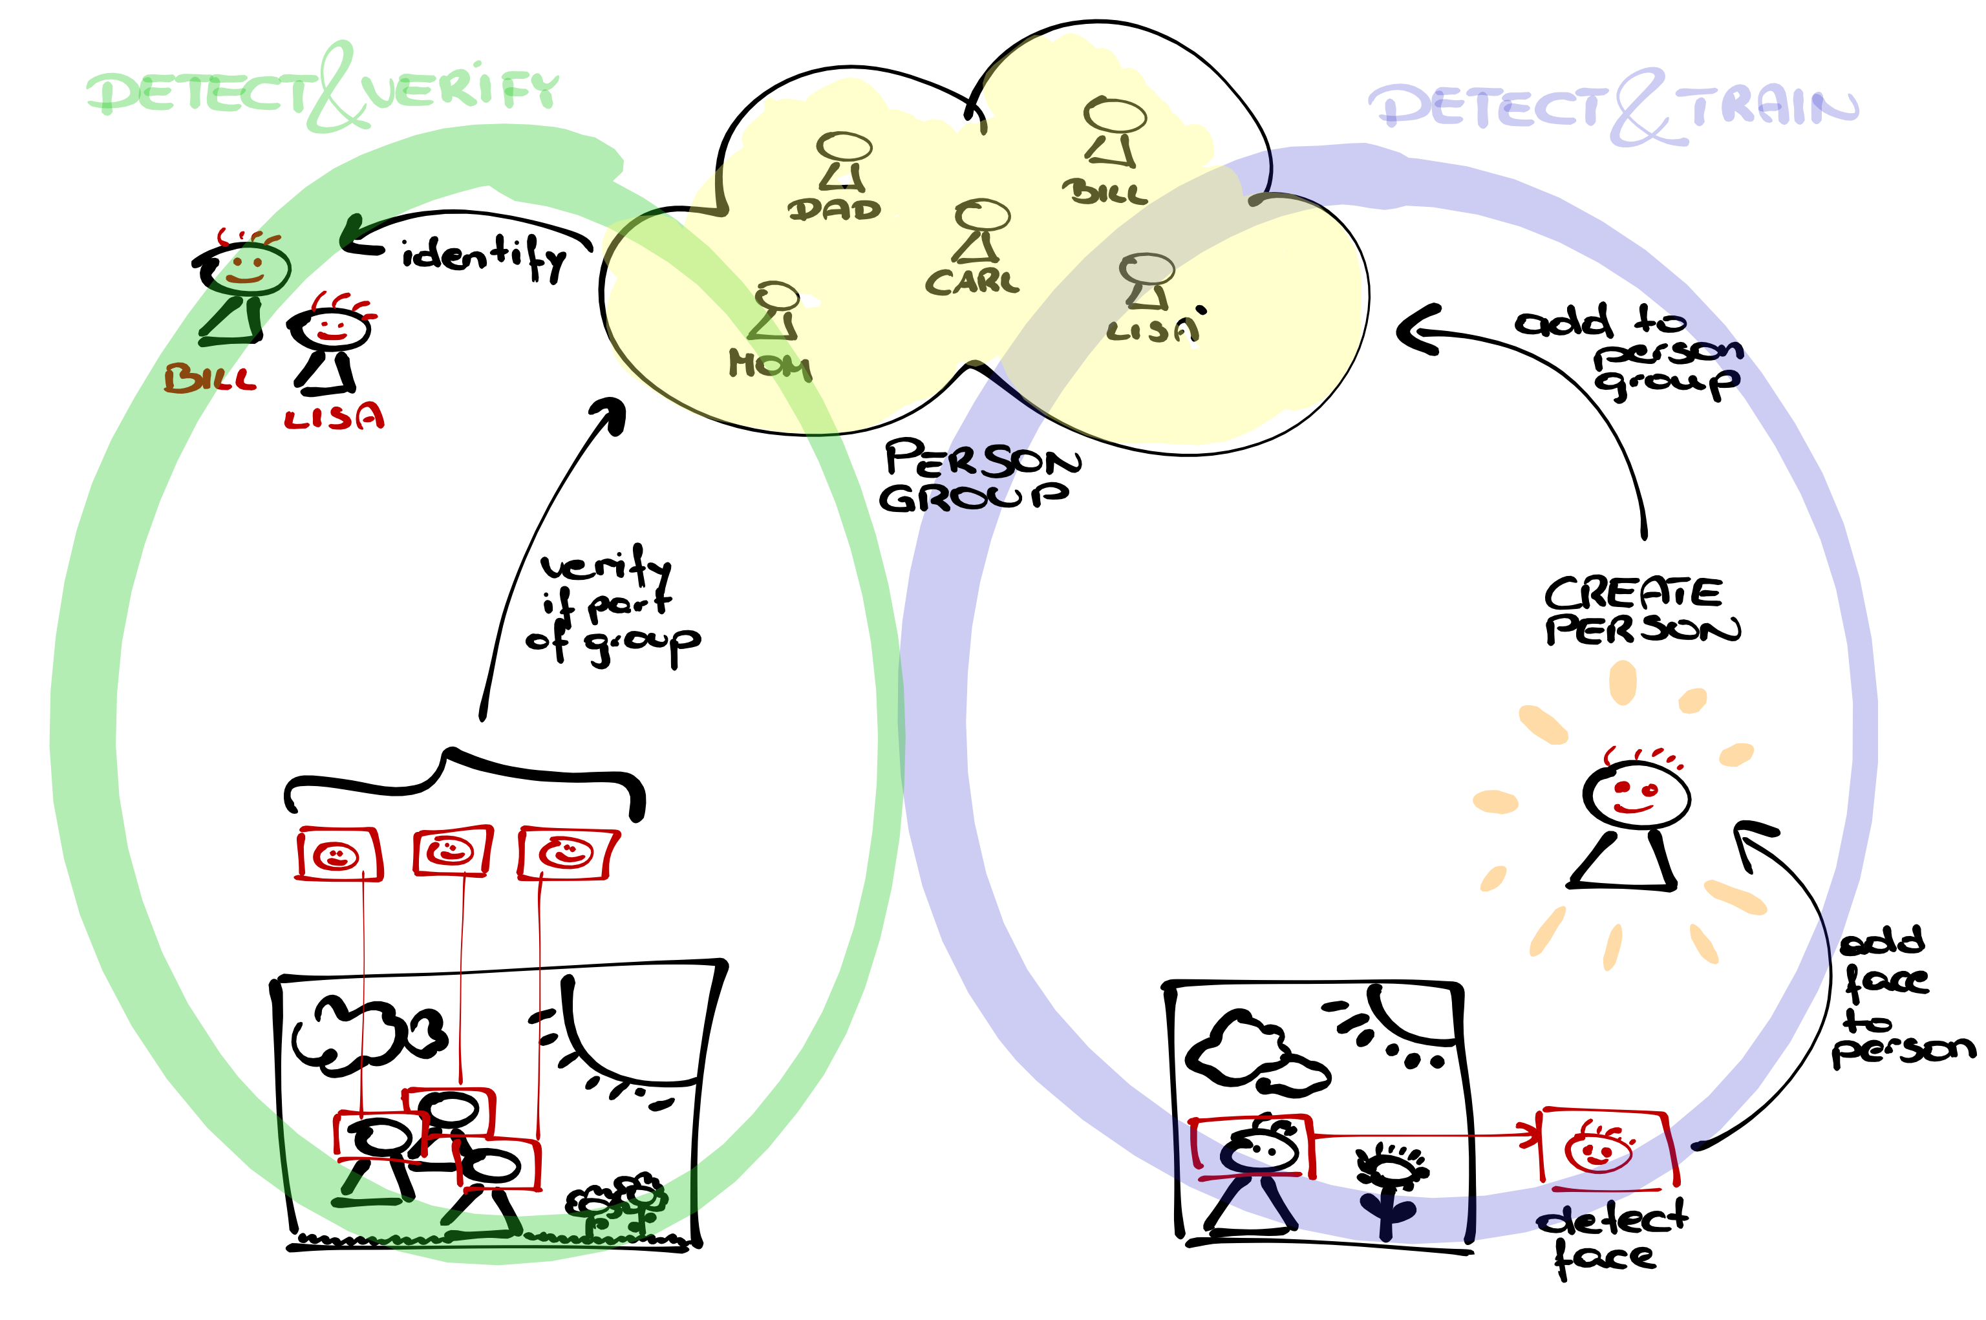

Face API
[*13]

Slide 20
Customized Services

Slide 21
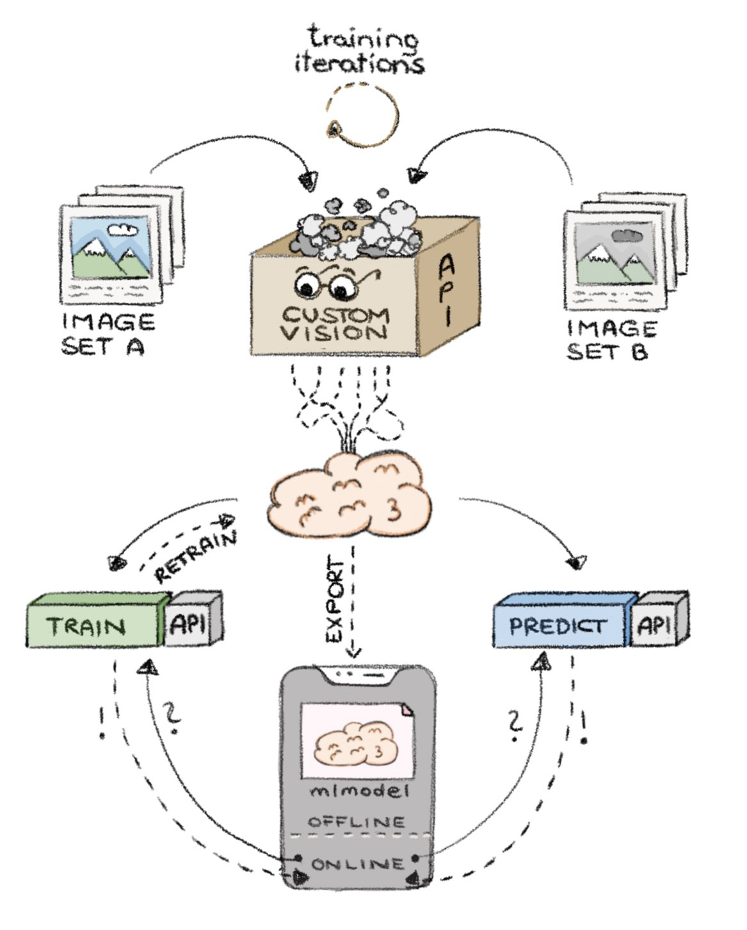
customvision.ai

Slide 22
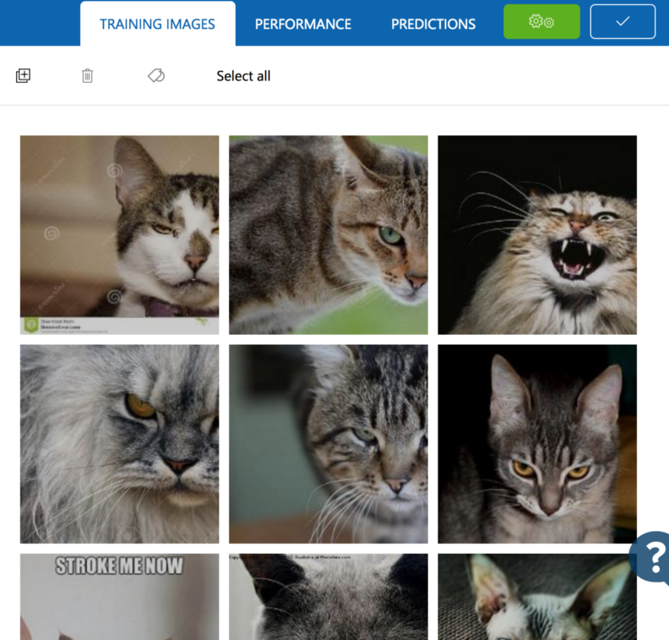
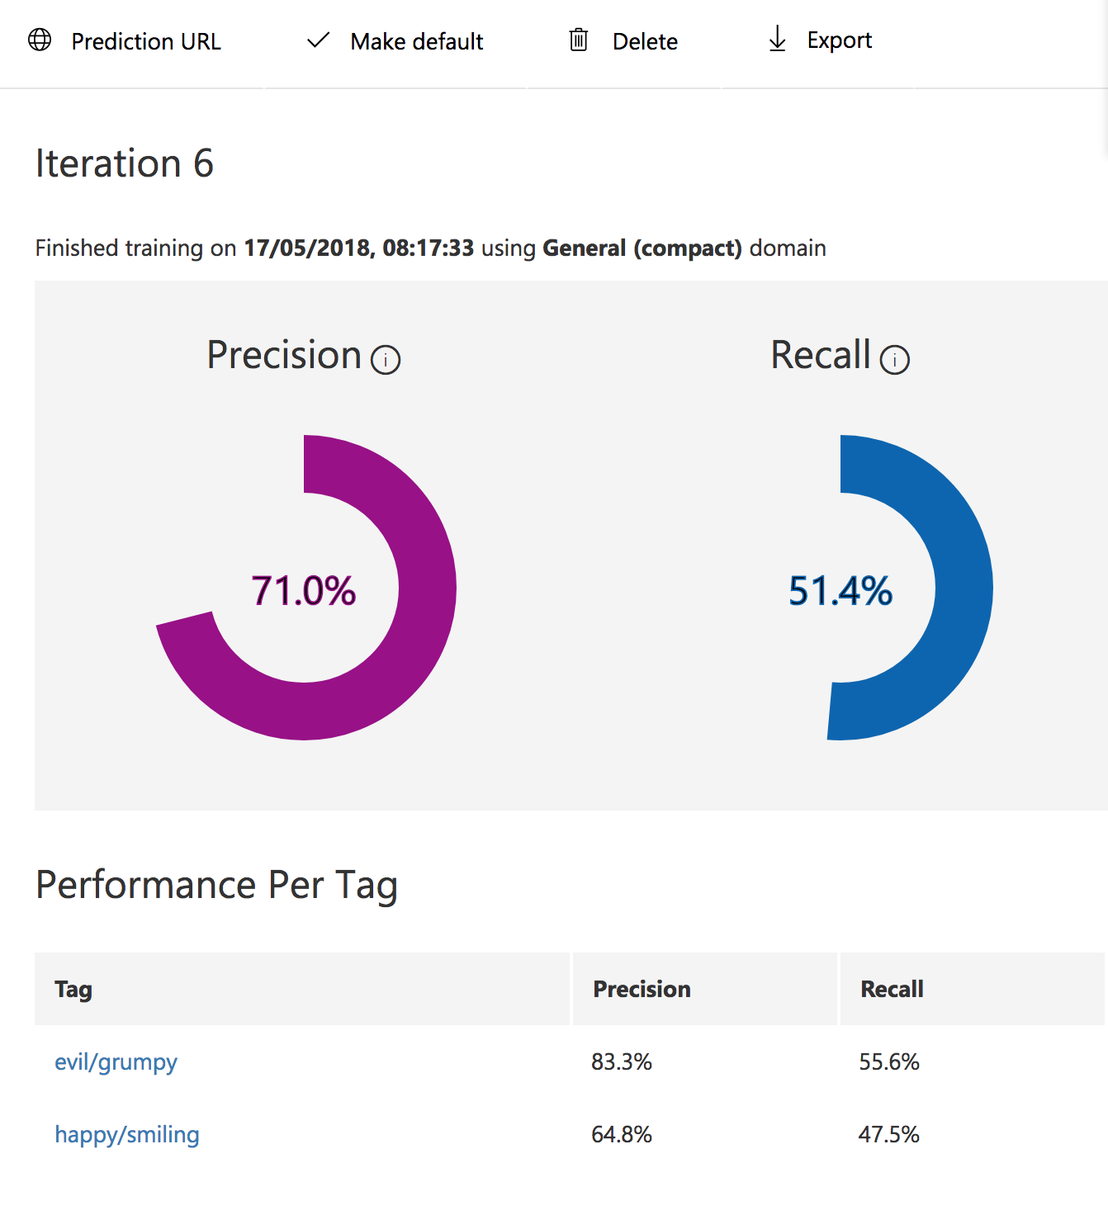
Label your data and start training…

Slide 23
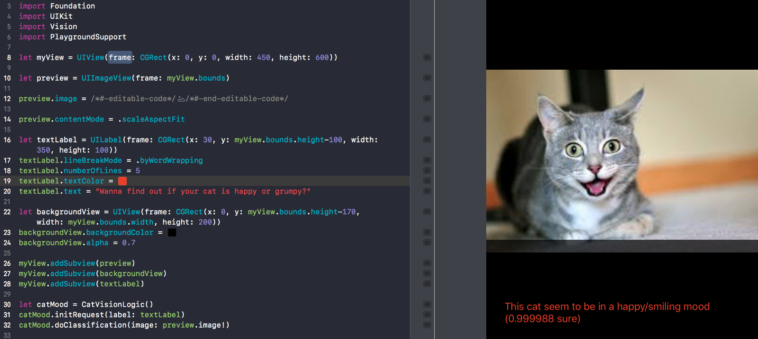
… and use your model in your apps!

Slide 24
Demo
🎬 📔
Video Indexer

Slide 25
DIY

Slide 26
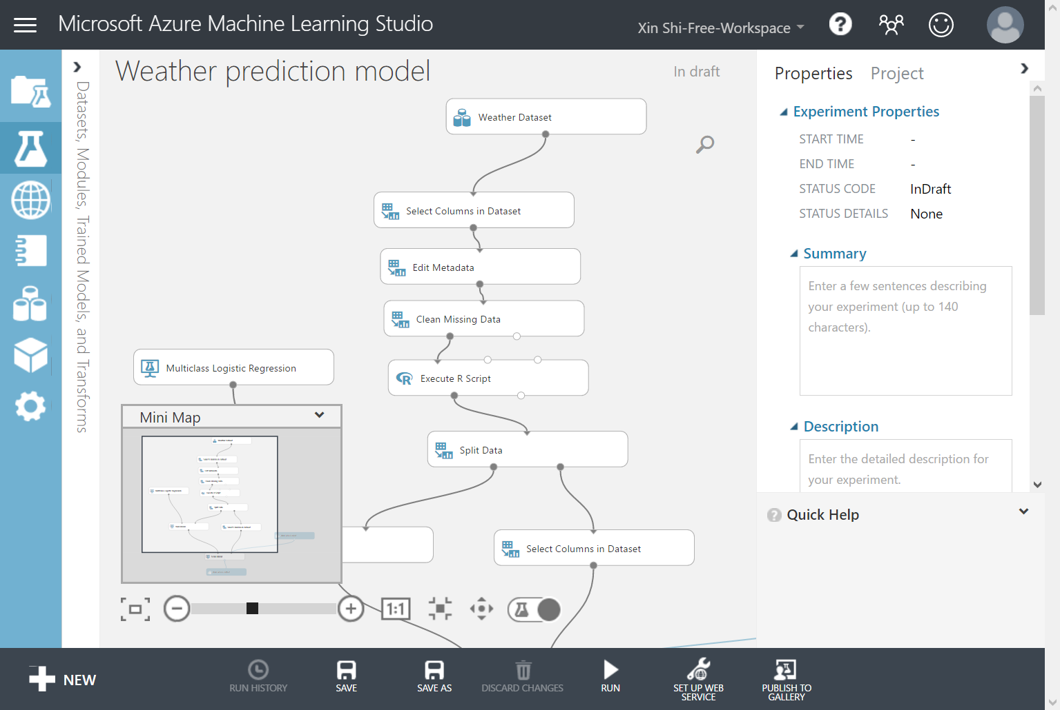

https://studio.azureml.net/

Slide 27




… you name it!
Use whatever floats your boat

Slide 28
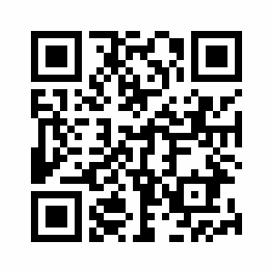

Merci :)
says
Manu Rink
Software Engineer
marink@microsoft.com
@codeprincess
github.com/codeprincess
Notes:
Thank you and merci! That's all I have :)

